Slide 1
Unit-3
CS44 Data Communications and Networking

Slide 2
Outline of Unit-3
Network Layer: Internet Protocol Version 4
IPv4 Addressing
Main and Auxiliary protocols
Routing Algorithms:
Distance-Vector(DV) Routing
Link-State Routing
Unicast Routing Protocols
Internet Structure
Routing Information Protocol
Open Shortest Path First
Border Gateway Protocol version 4

Slide 3
Internet Protocol Version
two versions
IP Version 4 (IPv4) - almost depleted
IP Version 6 (IPv6)
Internet address or IP address - identifier used in IP layer of the TCP/IP protocol suite to identify the connection of each device to the Internet
IPv4 address is a 32-bit address
Unique - If a device has two connections to the Internet, via two networks, it has two IPv4 addresses
universal - the addressing system must be accepted by any host that wants to be connected to the Internet
the address of the connection, not the host or the router
because if the device is moved to another network, the IP address may be changed

Slide 4
Address space
total number of addresses used by the protocol
If a protocol uses b bits to define an address, the address space is 2^b because each bit can have two different values (0 or 1).
IPv4 uses 32-bit addresses, which means that the address space is 2^32 or 4,294,967,296 (more than 4 billion).
If there were no restrictions, more than 4 billion devices could be connected to the Internet.

Slide 5
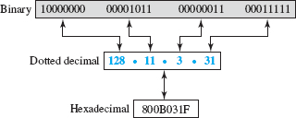
Notation
binary notation (base 2) - displayed as 32 bit.
To make the address more readable, one or more spaces are usually inserted between each octet (8 bits).
Each octet is often referred to as a byte
dotted-decimal notation (base 256) - usually written in decimal form with a decimal point (dot) separating the bytes
each byte (octet) is only 8 bits, each number in the dotted-decimal notation is between 0 and 255
hexadecimal notation (base 16)
Each hexadecimal digit is equivalent to 4 bits. This means that a 32-bit address has eight hexadecimal digits

Slide 6
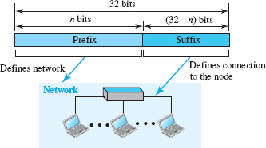
Hierarchy in Addressing
any communication network that involves delivery - the addressing system is hierarchical
32-bit IPv4 address - hierarchical but is divided only into two parts
Prefix-defines the network (n-bits)
fixed length -classful addressing - obsolete
variable length-classless addressing-
Address (suffix) - the node - connection of a device to the Internet (32-n bits)
Notes:
The network identifier
in the IPv4 was first designed as a fixed-length prefix. This scheme, which is
now, is referred to as. The new scheme, which
is referred to as, uses a variable-length network prefix.
First, we briefly discuss classful addressing; then we concentrate on
classless addressing.

Slide 7
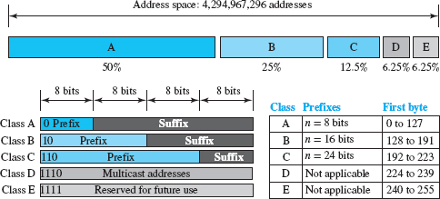
Classful Addressing
to accommodate both small and large networks, three fixed-length prefixes were designed instead of one (n = 8, n = 16, and n = 24)
The whole address space was divided into five classes (classes A, B, C, D, and E)
helps us to understand classless addressing.

Slide 8
Classful Addressing cont…
class A - network length is 8 bits but because the first bit is 0, we can have only 7 bits as the network identifier.
2⁷ = 128 networks in the world
class B - the network length is 16 bits, but because the first 2 bits are (10)₂, we can have only 14 bits as the network identifier
2¹⁴ = 16,384 networks in the world
class C - network length is 24 bits but because the first 3 bits are (110)₂ we can have only 21 bits as the network identifier.
2²¹ = 2,097,152networks in the world
Class D is not divided into prefix and suffix. It is used for multicast addresses
class E -All addresses that start with 1111 in binary belong to.
As in class D, class E is not divided into prefix and suffix and is used as reserve.
Notes:
In.
All addresses that start with (110)2 belong to class C. In class C, the
network length is 24 bits, but because 3 bits define the class, we can have
only 21 bits as the network identifier. This means there are 221 = 2,097,152
networks in the world that can have a class C address.
Class D is not divided into prefix and suffix. It is used for multicast
addresses. All addresses that start with 1111 in binary belong to class E. As
in class D, class E is not divided into prefix and suffix and is used as
reserve.

Slide 9
Address Depletion
the addresses were not distributed properly so the Internet was faced with the problem of the addresses being rapidly used up, resulting in no more addresses being available for organizations and individuals that needed to have an Internet connection.
Eg. class A -assigned to only 128 organizations in the world, but each organization would need to have one single network (seen by the rest of the world) with 16,777,216 nodes (computers in this single network).
Because there were only a few organizations that are this large, most of the addresses in this class were wasted (unused).
Class B addresses were designed for midsize organizations, but many of the addresses in this class also remained unused.
Class C addresses have a completely different design flaw. The number of addresses that can be used in each network (256) was so small that most companies were not comfortable using a block in this address.
Class E addresses were almost never used, wasting the whole class.
larger address space requires the length of IP addresses be increased -means the format of the IP packets needs to be changed (IPv6) - long-range solution
Short term solution – classless addressing (no classes)

Slide 10
Classless Addressing
new architecture announced in 1996 by the Internet authorities
use the same address space but change the distribution of addresses to provide a fair share to each organization
Motivation
Solution to address depletion
Manage Internet Service Providers (ISPs)
During the 1990s, Internet Service Providers (ISPs) came into prominence
An ISP is an organization that provides Internet access and services for individuals, small businesses, and midsize organizations that do not want to create an Internet site and become involved in providing Internet services (such as electronic mail) for their employees.
An ISP is granted a large range of addresses and then subdivides the addresses (in groups of 1, 2, 4, 8, 16, and so on), giving a range of addresses to a household or a small business
connected via a dial-up modem, DSL, or cable modem to the ISP

Slide 11

Classless Addressing
whole address space is divided into non overlapping variable-length blocks - block of 2⁰, 2¹, 2², …, 2³² addresses
restrictions - the number of addresses in a block needs to be a power of 2
An organization can be granted one block of addresses.
prefix in an address defines the block (network)
suffix defines the node (device)

Slide 12

Prefix Length: Slash Notation
how to find the prefix length if an address is given?
Because the prefix length is not inherent in the address, we need to separately give the length of the prefix.
the prefix length, n, is added to the address, separated by a slash.
The notation is informally referred to as slash notation and formally as classless interdomain routing (CIDR, pronounced cider) strategy.

Slide 13
Extracting Information from an Address
Given any address in the block, we normally like to know three pieces of information about the block to which the address belongs:
the number of addresses
the first address in the block -keep the n leftmost bits and set the (32 − n)
the last address- keep the n leftmost bits and set the (32 − n) rightmost bits all to 0s rightmost bits all to 1s
Because the value of prefix length, n, is given, we can easily find these three pieces of information

Slide 14
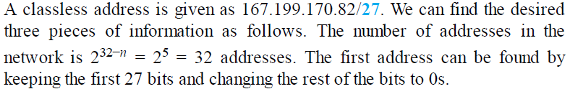
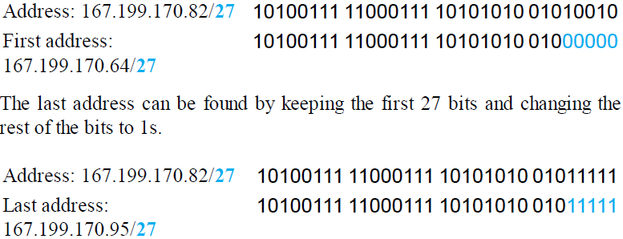
Example 1

Slide 15
Address Mask
Another way to find the first and last addresses in the block is to use the address mask.
The address mask is a 32-bit number in which the n leftmost bits are set to 1s and the rest of the bits (32 − n) are set to 0s.
A computer can easily find the address mask because it is the complement of (2^{32−n} − 1).
The reason for defining a mask in this way is that it can be used by a computer program to extract the information in a block, using the three bitwise operations NOT, AND, and OR.
1. The number of addresses in the block N = NOT (Mask) + 1.
2. The first address in the block = (Any address in the block) AND (Mask).
3. The last address in the block = (Any address in the block) OR [(NOT (Mask)].

Slide 16
Imagine a city with streets and house numbers.
The street name is like the network.
The house number is like the host.
Now, if you want to deliver a letter:
First, you find the correct street (network).
Then, you find the house number (host) on that street.
The address mask is like a rule that tells you: "Only look at the street name first; ignore the house number until you are on the right street."
Without this rule, you would waste time checking every house in the city!

Slide 17
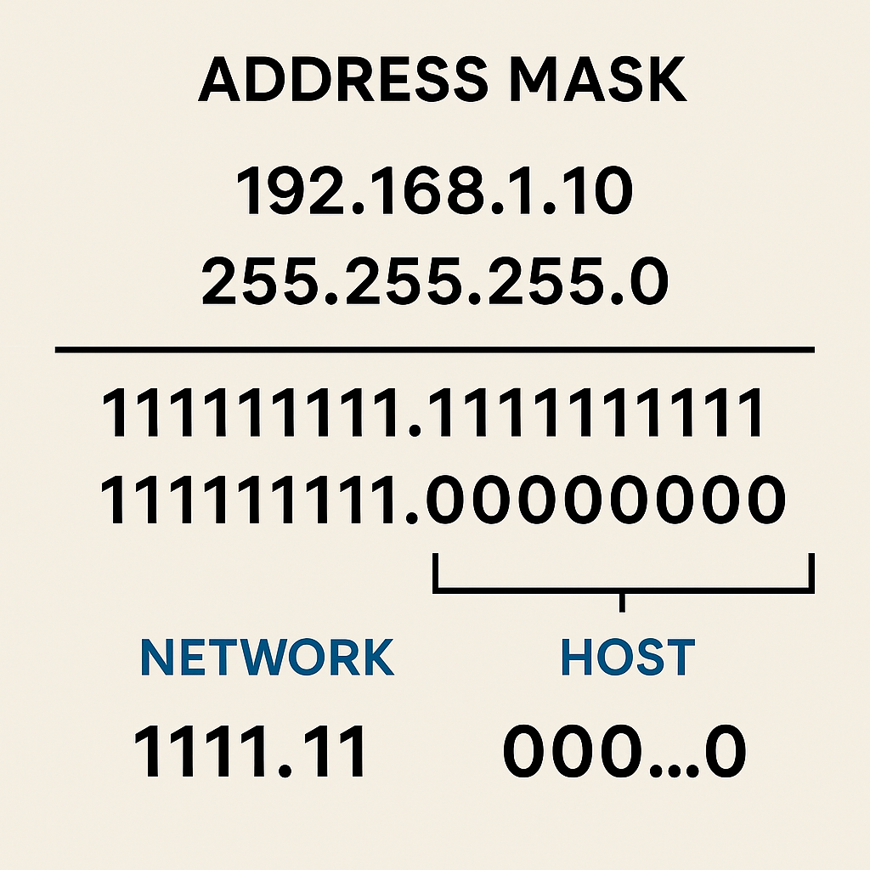

Slide 18
Address Mask
repeat Example 1 using the mask. The mask in dotted-decimal notation is 256.256.256.224. The AND, OR, and NOT operations can be applied to individual bytes using calculators and applets at the book website.
Number of addresses in the block: N = NOT (mask) + 1 = 0.0.0.31 + 1 = 32 addresses
First address: First = (address) AND (mask) = 167.199.170. 82
Last address: Last = (address) OR (NOT mask) = 167.199.170. 255

Slide 19
Network Address
The preceding examples show that, given any address, we can find all information about the block.
The first address, the network address, is particularly important because it is used in routing a packet to its destination network.
For the moment, let us assume that an internet is made up of m networks and a router with m interfaces.
When a packet arrives at the router from any source host, the router needs to know to which network the packet should be sent and from which interface the packet should be sent out.
When the packet arrives at the network, it reaches its destination host using link layer addressing
After the network address has been found, the router consults its forwarding table to find the corresponding interface from which the packet should be sent out.
The network address is the identifier of the network; each network is identified by its network address.

Slide 20
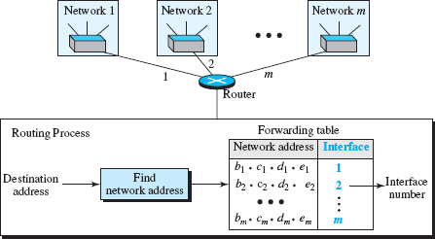
Network Address

Slide 21
Block Allocation
How are the blocks allocated?
Global authority called the Internet Corporation for Assigned Names and Numbers (ICANN)
However, ICANN does not normally allocate addresses to individual Internet users.
It assigns a large block of addresses to an ISP (or a larger organization that is considered an ISP in this case).
For the proper operation of the CIDR, two restrictions need to be applied to the allocated block
The number of requested addresses, N, needs to be a power of 2
The requested block needs to be allocated where there are a contiguous number of available addresses in the address space
first address needs to be divisible by the number of addresses in the block
First address = (prefix in decimal) × 2^{32−n} = (prefix in decimal) × N
Notes:
two restrictions need to be applied to the
allocated block.
1. The number of requested addresses, N, needs to be a power of 2. The
reason is that N = 232−n or n = 32 − log2 N. If N is not a power of 2, we
cannot have an integer value for n.
2. The requested block needs to be allocated where there are a contiguous
number of available addresses in the address space. However, there is a
restriction on choosing the first address in the block. The first address
needs to be divisible by the number of addresses in the block. The reason
is that the first address needs to be the prefix followed by (32 − n)
number of 0s. The decimal value of the first address is then

Slide 22
Example
An ISP has requested a block of 1000 addresses. Because 1000 is not a power of 2, 1024 addresses are granted.
The prefix length is calculated as n = 32 − log₂ 1024 = 22.
An available block, 18.14.12.0/22, is granted to the ISP.
It can be seen that the first address in decimal is 302,910,464, which is divisible by 1024.

Slide 23
Subnetting
Created more levels of hierarchy
An organization (or an ISP) that is granted a range of addresses may divide the range into several subranges and assign each subrange to a subnetwork (or subnet).
N - total number of addresses granted to the organization
n - prefix length
Nsub- the assigned number of addresses to each subnetwork
nsub - the prefix length for each subnetwork
steps to guarantee the proper operation of the subnetworks
The number of addresses in each subnetwork should be a power of 2.
The prefix length for each subnetwork : nsub = 32 − log₂ Nsub
The starting address in each subnetwork should be divisible by the number of addresses in that subnetwork - This can be achieved if we first assign addresses to larger subnetworks.
each subnetwork information (first and last address) – same process seen before

Slide 24
Example
An organization is granted a block of addresses with the beginning address 14.24.74.0/24. The organization needs to have three subblocks of addresses to use in its three subnets: one subblock of 10 addresses, one subblock of 60 addresses, and one subblock of 120 addresses. Design the subblocks.
There are 2^{32–24} = 256 addresses in this block.
The first address is 14.24.74.0/24;
the last address is 14.24.74.255/24.
To satisfy the third requirement, we assign addresses to subblocks, starting with the largest and ending with the smallest one.

Slide 25
Example
a. The number of addresses in the largest subblock, which requires 120 addresses, is not a power of 2.
We allocate 128 addresses.
The subnet mask for this subnet can be found as n1 = 32 − log₂ 128 = 25.
The first address in this block is 14.24.74.0/25;
the last address is 14.24.74.127/25.
b. The number of addresses in the second largest subblock, which requires 60 addresses, is not a power of 2 either.
We allocate 64 addresses
The subnet mask for this subnet can be found as n2 = 32 − log2 64 = 26.
The first address in this block is 14.24.74.128/26;
the last address is 14.24.74.191/26.

Slide 26
Example
c. The number of addresses in the smallest subblock, which requires 10 addresses, is not a power of 2 either.
allocate 16 addresses.
The subnet mask for this subnet can be found as n3 = 32 − log₂ 16 = 28.
The first address in this block is 14.24.74.192/28;
the last
If we add all addresses in the previous subblocks, the result is 208 addresses,
means 48 addresses are left in reserve.
The first address in this range is 14.24.74.208.
The last address is 14.24.74.255.

Slide 27
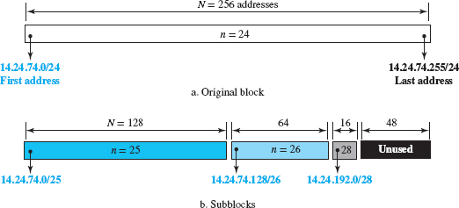
Example

Slide 28
Address Aggregation
One of the advantages of the CIDR strategy is address aggregation (sometimes called address summarization or route summarization).
When blocks of addresses are combined to create a larger block, routing can be done based on the prefix of the larger block.
ICANN assigns a large block of addresses to an ISP. Each ISP in turn divides its assigned block into smaller subblocks and grants the subblocks to its customers.

Slide 29
Address Aggregation
Four small blocks of addresses are assigned to four organizations by an ISP.
The ISP combines these four blocks into one single block and advertises the larger block to the rest of the world.
Any packet destined for this larger block should be sent to this ISP.
It is the responsibility of the ISP to forward the packet to the appropriate organization.
a postal network - All packages coming from outside a country are sent first to the capital and then distributed to the corresponding destination.

Slide 30
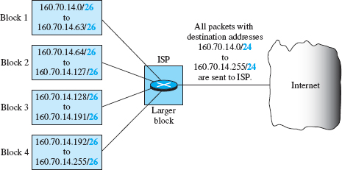
Address Aggregation

Slide 31
Main and Auxiliary Protocols
The network layer in version 4 - one main protocol and three auxiliary protocols
The main protocol, Internet Protocol version 4 (IPv4)
The Internet Control Message Protocol version 4 (ICMPv4)
The Internet Group Management Protocol (IGMP)
The Address Resolution Protocol (ARP)

Slide 32
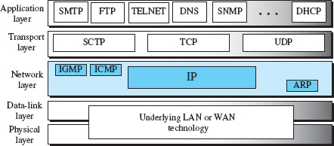
Main and Auxiliary Protocols
Auxiliary protocol: help IPv4 in multicasting
Main protocol: responsible for packetizing, forwarding, and delivery of a packet
Auxiliary protocol: glue the network and data-link layers in mapping network-layer addresses to link-layer addresses
Auxiliary protocol: helps IPv4 to handle some errors that may occur in the network layer delivery

Slide 33
IPv4
Unreliable datagram protocol—a best-effort delivery service.
Best effort means that IPv4 packets can be corrupted, be lost, arrive out of order, be delayed or create congestion for the network.
If reliability is important, IPv4 must be paired with a reliable transport-layer protocol such as TCP.
Common best-effort delivery service is the post office.
The post office does its best to deliver the regular mail but does not always succeed.
The post office itself does not keep track of every letter and cannot notify a sender of loss or damage of one.
If an unregistered letter is lost or damaged in the mail, the would-be recipient will not receive the correspondence and the sender will need to re-create it.

Slide 34
IPv4
IPv4 is a connectionless protocol that uses the datagram approach.
This means that each datagram is handled independently, and each datagram can follow a different route to the destination
This implies that datagrams sent by the same source to the same destination could arrive out of order.
IPv4 relies on a higher-level protocol to take care of all these problems.

Slide 35
IPv4 Datagram Format
first service provided by IPv4 – packetizing
IPv4 format of a packet in which the data coming from the upper layer or other protocols are encapsulated.
Packets used by the IP are called datagrams.
A datagram is a variable-length packet consisting of two parts:
the header is 20 to 60 bytes in length and contains information essential to routing and delivery
first 20 bytes are essential and together are called the main header
next 40 bytes include options and padding that may or may not be present
It is customary in TCP/IP to show the header in 4-byte sections.
payload (data).
The header

Slide 36
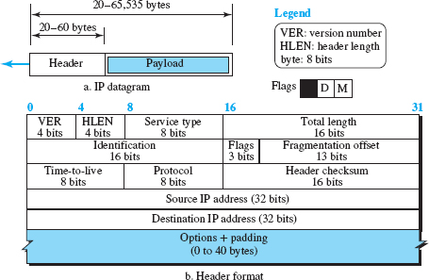
IPv4 Datagram Format

Slide 37
IPv4 Datagram Format
Version specifies the IP version.
Header length (HLEN) specifies the length of the header (including options and padding) in terms of 4-byte blocks. For example, if the total header of a packet (including options and padding) is 60B, HL=60B/4B=15 which is 1111 in binary.
Type of service specifies the quality-of-service (QoS) requirements of the packet, such as priority level, delay, reliability, throughput, and cost.
Total length specifies the total length of the packet in bytes, including the header and data. A total of 16 bits are assigned to this field. Length of data = total length − (HLEN) × 4
Helps to determine how much is really data and how much is padding
Identification, flags, and fragment offset are used for packet fragmentation and reassembly.

Slide 38
IPv4 Datagram Format
Time to live specifies the maximum number of hops after which a packet must be discarded.
value is approximately 2 times the maximum number of routes between any two hosts.
Each router that processes the datagram decrements this number by one.
If this value, after being decremented, is zero, the router discards the datagram.
Protocol specifies the protocol of packet in payload.
A datagram can carry a packet from other protocols that directly use the service of the IP, such as some routing protocols, any transport-layer protocol or some auxiliary protocols.
provides multiplexing at the source and demultiplexing at the destination,

Slide 39
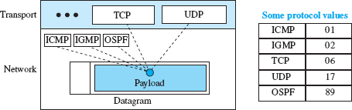
IPv4 Datagram Format

Slide 40
IPv4 Datagram Format
Header checksum is a method of error detection
the value of some fields, such as TTL, which are related to fragmentation and options, may change from router to router, the checksum needs to be recalculated at each router
Source address and destination address are 32-bit fields specifying the source address and the destination address, respectively.
remain unchanged during the time the IP datagram travels from the source host to the destination host.
Options is a rarely used variable-length field to specify security level, timestamp, and type of route.
used for network testing and debugging
Padding is used to ensure that the header is a multiple of 32 bits.

Slide 41
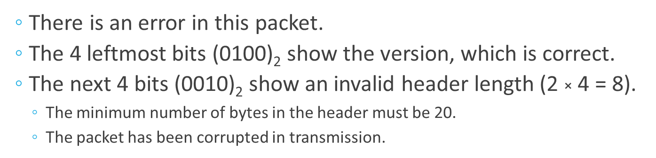
Example
An IPv4 packet has arrived with the first 8 bits as (01000010)₂. The receiver discards the packet. Why?

Slide 42
Example
In an IPv4 packet, the value of HLEN is (1000)₂. How many bytes of options are being carried by this packet?
The HLEN value is 8, which means the total number of bytes in the header is 8 × 4, or 32 bytes.
The first 20 bytes are the base header, the next 12 bytes are the options.

Slide 43
Example
In an IPv4 packet, the value of HLEN is 5, and the value of the total length field is (0028)₁₆. How many bytes of data are being carried by this packet?
The HLEN value is 5, which means the total number of bytes in the header is 5 × 4, or 20 bytes (no options).
The total length is (0028)₁₆ or 40 bytes, which means the packet is carrying 20 bytes of data (40 − 20).

Slide 44
Example
An IPv4 packet has arrived with the first few hexadecimal digits as shown. (45000028000100000102 … )₁₆
How many hops can this packet travel before being dropped? To which upper-layer protocol do the data belong?
To find the time-to-live field, we skip 8 bytes (16 hexadecimal digits).
The time-to-live field is the ninth byte, which is (01)₁₆.
This means the packet can travel only one hop.
The protocol field is the next byte (02)₁₆, which means that the upper-layer protocol is IGMP.

Slide 45
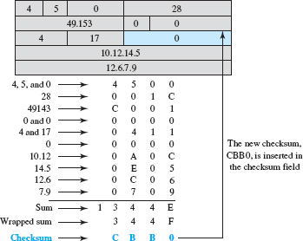
Example
Figure shows an example of a checksum calculation for an IPv4 header without options. The header is divided into 16-bit sections. All the sections are added, and the sum is complemented after wrapping the leftmost digit. The result is inserted in the checksum field.
Note that the calculation of wrapped sum and checksum can also be done as follows in hexadecimal:
Wrapped Sum = Sum mod FFFF
Checksum = FFFF − Wrapped Sum

Slide 46
Fragmentation
datagram can travel through different networks.
Each router decapsulates the IP datagram from the frame it receives, processes it, and then encapsulates it in another frame.
The format and size of the received frame depend on the protocol used by the physical network through which the frame has just traveled.
The format and size of the sent frame depend on the protocol used by the physical network through which the frame is going to travel.
For example, if a router connects a LAN to a WAN, it receives a frame in the LAN format and sends a frame in the WAN format.

Slide 47
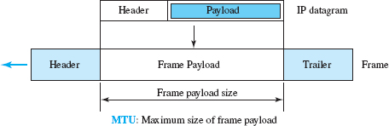
Maximum Transfer Unit (MTU)
Each link-layer protocol has its own frame format.
when a datagram is encapsulated in a frame, the total size of the datagram must be less than this maximum size, which is defined by the restrictions imposed by the hardware and software used in the network

Slide 48
Fragmentation
The value of the maximum transfer unit (MTU) differs from one physical network protocol to another.
For example, the value for a LAN is normally 1500 bytes, but for a WAN it can be larger or smaller.
need a mechanism that avoids requiring large buffers at intermediate routers to store the fragments.
To make the IP protocol independent of the physical network, the designers decided to make the maximum length of the IP datagram equal to 65,535 bytes.
This makes transmission more efficient if one day we use a link-layer protocol with an MTU of this size.
However, for other physical networks, we must divide the datagram to make it possible for it to pass through these networks. This is called fragmentation.
payload of the IP datagram is fragmented
most parts of the header, with the exception of some options, must be copied by all fragments.

Slide 49
Fragmentation
When a datagram is fragmented, each fragment has its own header with most of the fields repeated, but some have been changed.
A fragmented datagram may itself be fragmented if it encounters a network with an even smaller MTU.
A datagram can be fragmented by the source host or any router in the path.
The reassembly of the datagram, however, is done only by the destination host, because each fragment becomes an independent datagram.
Whereas the fragmented datagram can travel through different routes, and we can never control or guarantee which route a fragmented datagram may take, all the fragments belonging to the same datagram should finally arrive at the destination host.
So it is logical to do the reassembly at the final destination.
An even stronger objection for reassembling packets during the transmission is the loss of efficiency it incurs.

Slide 50
Fragmentation
The host or router that fragments a datagram must change the values of three fields: flags, fragmentation offset, and total length.
The rest of the fields must be copied.
the value of the checksum must be recalculated regardless of fragmentation.
The identification field identifies a datagram originating from the source host.
Counter is initialized to a positive number
When a datagram is fragmented, the value in the identification field is copied into all fragments
identification number helps the destination in reassembling the fragmented packets.
The offset field indicates the position of a fragment in the sequence of fragments making up the packet. The lengths of all the fragments, with the exception of the last one, must be divisible by 8.

Slide 51
Fragmentation
The 3-bit flags field defines three flags.
The leftmost bit is reserved (not used).
The second bit (D bit) is called the do not fragment bit.
If its value is 1, the machine must not fragment the datagram.
If it cannot pass the datagram through any available physical network, it discards the datagram and sends an ICMP error message to the source host
If its value is 0, the datagram can be fragmented if necessary.
The third bit (M bit) is called the more fragment bit.
If its value is 1, it means the datagram is not the last fragment; there are more fragments after this one.
If its value is 0, it means this is the last or only fragment.

Slide 52
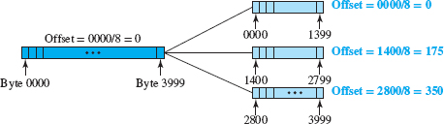
Fragmentation
The 13-bit fragmentation offset field shows the relative position of this fragment with respect to the whole datagram.
It is the offset of the data in the original datagram measured in units of 8 bytes.
Datagram with a data size of 4000 bytes (numbered 0 to 3999) fragmented into three fragments.
The first fragment carries bytes 0 to 1399. The offset for this datagram is 0/8 = 0.
The second fragment carries bytes 1400 to 2799; the offset value for this fragment is 1400/8 = 175.
Finally, the third fragment carries bytes 2800 to 3999. The offset value for this fragment is 2800/8 = 350.

Slide 53
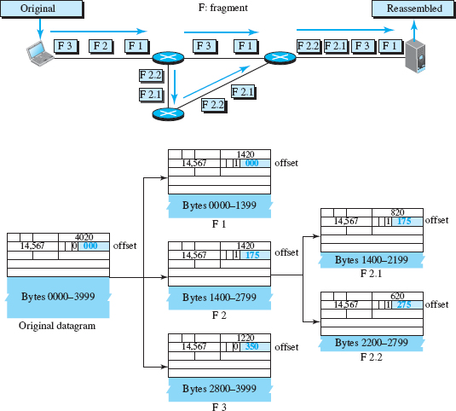
Fragmentation
The original packet starts at the client; the fragments are reassembled at the Server
M bit set for all fragments except the last
the second fragment is itself fragmented later into two fragments of 800 bytes and 600 bytes, but the offset shows the relative position of the fragments to the original data.

Slide 54
Fragmentation
Reassembling strategy:
a. The first fragment has an offset field value of zero.
b. Divide the length of the first fragment by 8. The second fragment has an offset value equal to that result.
c. Divide the total length of the first and second fragment by 8. The third fragment has an offset value equal to that result.
d. Continue the process. The last fragment has its M bit set to 0.

Slide 55
Fragmentation - example
Why value of the offset is measured in units of 8 bytes?
the length of the offset field is only 13 bits long and cannot represent a sequence of bytes greater than 8191.
This forces hosts or routers that fragment datagrams to choose the size of each fragment so that the first byte number is divisible by 8.

Slide 56
Fragmentation - example
A packet has arrived with an M bit value of 0. Is this the first fragment, the last fragment, or a middle fragment? Do we know if the packet was fragmented?
If the M bit is 0, it means that there are no more fragments; the fragment is the last one.
However, we cannot say if the original packet was fragmented or not.
A nonfragmented packet is considered the last fragment.

Slide 57
Fragmentation - example
A packet has arrived with an M bit value of 1. Is this the first fragment, the last fragment, or a middle fragment? Do we know if the packet was fragmented?
If the M bit is 1, it means that there is at least one more fragment.
This fragment can be the first one or a middle one, but not the last one.
We don’t know if it is the first one or a middle one; we need more information (the value of the fragmentation offset).

Slide 58
Fragmentation - example
A packet has arrived with an M bit value of 1 and a fragmentation offset value of 0. Is this the first fragment, the last fragment, or a middle fragment?
Because the M bit is 1, it is either the first fragment or a middle one.
Because the offset value is 0, it is the first fragment.

Slide 59
Fragmentation - example
A packet has arrived in which the offset value is 100. What is the number of the first byte? Do we know the number of the last byte?
To find the number of the first byte, we multiply the offset value by 8.
This means that the first byte number is 800.
We cannot determine the number of the last byte unless we know the length of the data.

Slide 60
Fragmentation - example
A packet has arrived in which the offset value is 100, the value of HLEN is 5, and the value of the total length field is 100. What are the numbers of the first byte and the last byte?
The first byte number is 100 × 8 = 800.
The total length is 100 bytes, and the header length is 20 bytes (5 × 4), which means that there are 80 bytes in this datagram.
If the first byte number is 800, the last byte number must be 879.

Slide 61
Routing Algorithms - Distance-Vector Routing
Goal - to find the best route
each node creates is its own least-cost tree with the rudimentary information it has about its immediate neighbors
The incomplete trees are exchanged between immediate neighbors to make the trees more and more complete and to represent the whole internet
router continuously tells all its neighbors about what it knows about the whole internet (although the knowledge can be incomplete).
Uses two important topics: the Bellman- Ford equation and the concept of distance vectors

Slide 62
Bellman-Ford Equation
find the least cost (shortest distance) between a source node, x, and a destination node, y, through some intermediary nodes (a, b, c, …) , when following are given
the costs between the source and the intermediary nodes
the least costs between the intermediary nodes and the destination
General case in which D_{ij} is the shortest distance and c_{ij} is the cost between nodes i and j
D_{xy} = min {(c_{xa} + D_{ay}), (c_{xb} + D_{by}), (c_{xc} + D_{cy}), …}
Bellman-Ford equation enables us to build a new least-cost path from previously established least-cost paths.

Slide 63
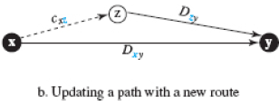
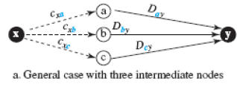
Bellman-Ford Equation
In distance-vector routing, normally we want to update an existing least cost with a least cost through an intermediary node, such as z, if the latter is shorter using
D_{xy} = min{D_{xy}, (c_{xz} + D_{zy})}
Graphical idea behind Bellman-Ford equation
(a → y), (b → y), and (c → y) as previously established least-cost paths
(x → y) as the new least-cost path

Slide 64
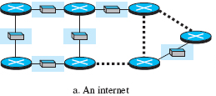
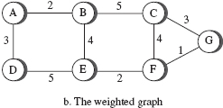

Distance vector
A least-cost tree is a combination of least-cost paths from the root of the tree to all destinations
These paths are graphically glued together to form the tree.
Distance-vector routing unglues these paths and creates a distance vector, a one-dimensional array to represent the tree
Consider an internet and its graphical representation

Slide 65
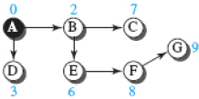

Distance vector
Tree for Node A and corresponding distance vector
Name of the distance vector defines the root, the indexes define the destinations, and the value of each cell defines the least cost from the root to the destination.
A distance vector gives only the least costs to the destinations not the path to the destinations as the least-cost tree does
how each node in an internet originally creates the corresponding vector?

Slide 66
Distance vector
Each node in an internet, when it is booted, creates a very rudimentary distance vector with the minimum information the node can obtain from its neighborhood.
The node sends some greeting messages out of its interfaces and discovers the identity of the immediate neighbors and the distance between itself and each neighbor
It then makes a simple distance vector by inserting the discovered distances in the corresponding cells and leaves the value of other cells as infinity
When we know only one distance between two nodes, it is the least cost.
These vectors are made asynchronously, when the corresponding node has been booted
The existence of all of them in a figure does not mean synchronous creation of them

Slide 67
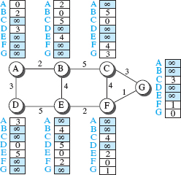
First distance vector for an internet
These rudimentary vectors cannot help the internet to effectively forward a packet.
For example, node A thinks that it is not connected to node G because the corresponding cell shows the least cost of infinity.

Slide 68
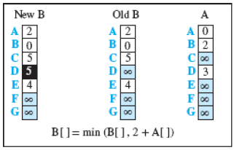
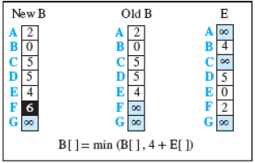
Updating distance vectors
After each node has created its vector, it sends a copy of the vector to all its immediate neighbors
After a node receives a distance vector from a neighbor, it updates its distance vector using the Bellman-Ford equation: D_{xy} = min{D_{xy}, (c_{xz} + D_{zy})}
Two asynchronous events, happening one after another with some time in between.
X[]: the whole vector
Node A has sent its vector to node B. Node B updates its vector using the cost c_{BA} = 2
Node E has sent its vector to node B. Node B updates its vector using the cost c_{EA} = 4

Slide 69
Updating distance vectors
After the first event, node B has one improvement in its vector; its least cost to node D has changed from infinity to 5 (via node A)
After the second event, node B has one more improvement in its vector; its least cost to node F has changed from infinity to 6 (via node E)
Exchanging vectors eventually stabilizes the system and allows all nodes to find the ultimate least cost between themselves and any other node
After updating a node, it immediately sends its updated vector to all neighbors.
Even if its neighbors have received the previous vector, the updated one may help more.

Slide 70
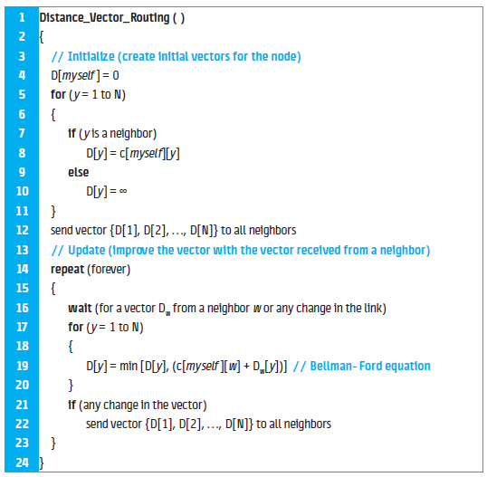
Distance-Vector Routing Algorithm
Lines 4 to 11 initialize the vector for the node
Lines 14 to 23 show how the vector can be updated after receiving a vector from the immediate neighbor
The for loop in lines 17 to 20 allows all entries (cells) in the vector to be updated after receiving a new vector.
the node sends its vector in line 12, after being initialized, and in line 22, after it is updated

Slide 71
Problem with DVR- Count to infinity
Any decrease in cost (good news) propagates quickly, but any increase in cost (bad news) will propagate slowly.
For a routing protocol to work properly, if a link is broken (cost becomes infinity), every other router should be aware of it immediately, but in distance-vector routing, this takes some time
It sometimes takes several updates before the cost for a broken link is recorded as infinity by all routers.
Example of count to infinity - Two-Node Loop

Slide 72



Count to infinity - Two-Node Loop
Both nodes A and B know how to reach node X
Link between A and X fails. Node A changes its table.
If A can send its table to B immediately, everything is fine.
However, the system becomes unstable if B sends its forwarding table to A before receiving A’s forwarding table.
Node A receives the update and, assuming that B has found a way to reach X, immediately updates its forwarding table.

Slide 73

Count to infinity - Two-Node Loop
Now A sends its new update to B.
Now B thinks that something has been changed around A and updates its forwarding table.
The cost of reaching X increases gradually until it reaches infinity. At this moment, both A and B know that X cannot be reached.
During this time the system is not stable.
Node A thinks that the route to X is via B; node B thinks that the route to X is via A.
If A receives a packet destined for X, the packet goes to B and then comes back to A.
Similarly, if B receives a packet destined for X, it goes to A and comes back to B.
Packets bounce between A and B, creating a two-node loop problem.

Slide 74
Solution to instability - split horizon
Instead of flooding the table through each interface, each node sends only part of its table through each interface.
If, according to its table, node B thinks that the optimum route to reach X is via A, it does not need to advertise this piece of information to A
the information has come from A (A already knows).
Taking information from node A, modifying it, and sending it back to node A is what creates the confusion.
Node A keeps the value of infinity as the distance to X - Later, when node A sends its forwarding table to B, node B also corrects its forwarding table.
The system becomes stable after the first update: Both nodes A and B know that X is not reachable.

Slide 75
Poisoned Reverse
Split horizon problem:
Normally, the corresponding protocol uses a timer
If there is no news about a route, the node deletes the route from its table
When node B in the previous scenario eliminates the route to X from its advertisement to A, node A cannot guess whether this is due to the split-horizon strategy (the source of information was A) or because B has not received any news about X recently
Solution: poisoned reverse strategy
B can still advertise the value for X, but if the source of information is A, it can replace the distance with infinity as a warning: “Do not use this value; what I know about this route comes from you.”
The two-node instability can be avoided using split horizon combined with poisoned reverse.
If the instability is between three nodes , it cannot be guaranteed

Slide 76
Link-State Routing
Directly follows creation of least cost trees and forwarding tables
Link state - the characteristic of a link (an edge) that represents a network in the internet
The cost associated with an edge defines the state of the link.
Links with lower costs are preferred to links with higher costs
if the cost of a link is infinity, it means that the link does not exist or has been broken.

Slide 77
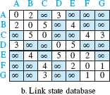
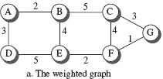
Link-State Database (LSDB)
To create a least-cost tree, each node needs to have a complete map of the network, which means it needs to know the state of each link
The collection of states for all links - link-state database (LSDB)
There is only one LSDB for the whole internet;
each node needs to have a duplicate of it to be able to create the least-cost tree
The LSDB can be represented as a two-dimensional array (matrix) in which the value of each cell defines the cost of the corresponding link.

Slide 78
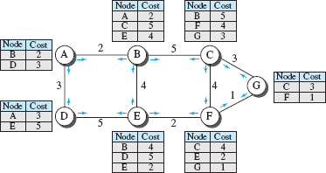
LSDB creation
“How can each node create this LSDB that contains information about the whole internet?”
done by a process called flooding
Each node can send some greeting messages to all its immediate neighbors (those nodes to which it is connected directly) to collect two pieces of information for each neighboring node:
the identity of the node
the cost of the link
The combination of these two pieces of information is called the LS packet (LSP)
LSP is sent out of each interface

Slide 79
LSDB creation
When a node receives an LSP from one of its interfaces, it compares the LSP with the copy it may already have.
If the newly arrived LSP is older than the one it has (found by checking the sequence number), it discards the LSP.
If it is newer or the first one received, the node discards the old LSP (if there is one) and keeps the received one.
It then sends a copy of it out of each interface except the one from which the packet arrived.
This guarantees that flooding stops somewhere in the network (where a node has only one interface)
After receiving all new LSPs, each node creates the comprehensive LSDB, which is same for each node and shows the whole map of the internet
Distance-vector routing algorithm | Link-state routing algorithm
Each router tells its neighbors what it knows about the whole internet | Each router tells the whole internet what it knows about its neighbors.

Slide 80
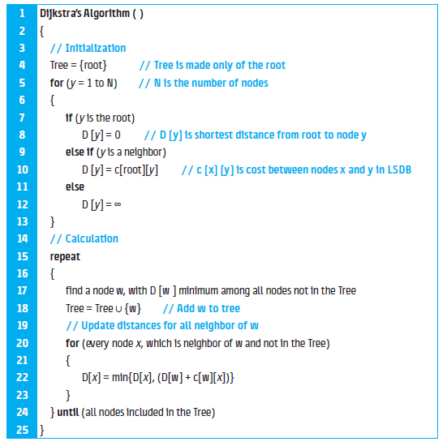
Formation of Least-Cost Trees
To create a least-cost tree for itself, using the shared LSDB, each node needs to run the famous iterative algorithm Dijkstra’s algorithm
1. The node chooses itself as the root of the tree, creating a tree with a single node, and sets the total cost of each node based on the information in the LSDB. (Lines 4 to 13)
2. The node selects one node, among all nodes not in the tree, which is closest to the root, and adds this to the tree. After this node is added to the tree, the cost of all other nodes not in the tree needs to be updated because the paths may have been changed. (Lines 16 to 23)
3. The node repeats step 2 until all nodes are added to the tree.

Slide 81
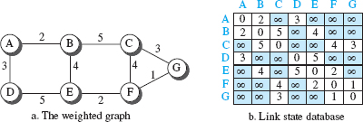
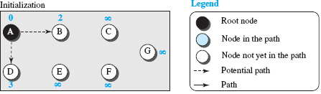
Formation of Least-Cost Trees

Slide 82
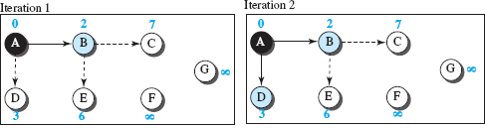
Formation of Least-Cost Trees

Slide 83
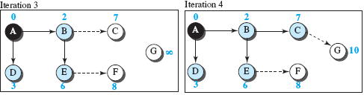
Formation of Least-Cost Trees

Slide 84
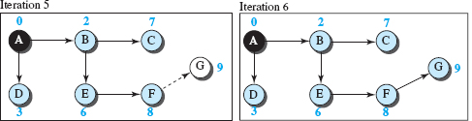
Formation of Least-Cost Trees

Slide 85
Unicast routing protocols
A protocol is more than an algorithm
Protocol needs to define
its domain of operation
the messages exchanged
Communication between routers
interaction with protocols in other domains
Three common protocols used in the Internet:
Routing Information Protocol (RIP), based on the distance-vector algorithm
Open Shortest Path First (OSPF), based on the link-state algorithm
Border Gateway Protocol (BGP), based on the path-vector algorithm

Slide 86
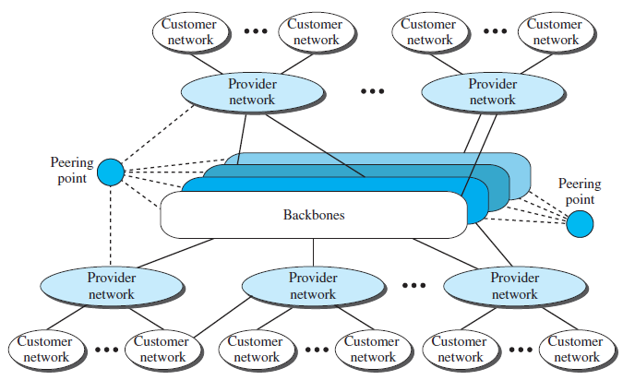
Internet
The largest internetwork in the world
Internet (uppercase I ), is composed of thousands of interconnected networks
Conceptual (not geographical) view of the Internet

Slide 87
Internet …
Internet consists of several
Backbones (top level)
large networks owned by some communication companies such as Sprint, Verizon (MCI), AT&T, and NTT
connected through some complex switching systems, called peering points
provider networks (second level) - smaller networks
use the services of the backbones for a fee
connected to backbones and sometimes to other provider networks
Customer networks (the edge of the Internet)
actually use the services provided by the Internet
pay fees to provider networks for receiving services
Backbones and provider networks are also called Internet Service Providers (ISPs)
Backbones = international ISPs
provider networks = national or regional ISPs

Slide 88
Hierarchical Routing
The Internet today is made up of a huge number of networks and routers that connect them.
Routing in the Internet cannot be done using one single protocol for two reasons:
a scalability problem - the size of the forwarding tables becomes huge, searching for a destination in a forwarding table becomes time consuming, and updating creates a huge amount of traffic
an administrative issue- related to the Internet structure
each ISP is run by an administrative authority
The administrator needs to have control in its system.
organization must be able to use as many subnets and routers as it needs, may desire that the routers be from a particular manufacturer, may wish to run a specific routing algorithm to meet the needs of the organization, and may want to impose some policy on the traffic passing through its ISP

Slide 89
Hierarchical Routing
Hierarchical routing means considering each ISP as an autonomous system (AS)
Each AS can run a routing protocol that meets its needs, but the global Internet runs a global protocol to glue all ASs together
The routing protocol run in each AS is referred to as intra-AS routing protocol, intradomain routing protocol, or interior gateway protocol (IGP);
RIP and OSP
the global routing protocol is referred to as inter-AS routing protocol, interdomain routing protocol, or exterior gateway protocol (EGP)
BGP
Several intradomain routing protocols -each AS is free to choose one, but only one interdomain protocol that handles routing between these entities

Slide 90
Autonomous Systems
each ISP is an autonomous system when it comes to managing networks and routers under its control
Although we may have small, medium-size, and large ASs, each AS is given an autonomous number (ASN) by the Internet Corporation for Assigned Names and Numbers (ICANN)
Each ASN is a 16-bit unsigned integer that uniquely defines an AS
The autonomous systems, however, are not categorized according to their size; they are categorized according to the way they are connected to other Ass

Slide 91
Types of Autonomous Systems
Stub AS- has only one connection to another AS
The data traffic can be either initiated or terminated in a stub AS
the data cannot pass through it
A good example of a stub AS is the costumer network, which is either the source or the sink of data.
Multihomed AS-can have more than one connection to other ASs, but it does not allow data traffic to pass through it
A good example of such an AS is some of the costumer ASs that may use the services of more than one provider network, but their policy does not allow data to be passed through them.
Transient AS - connected to more than one other AS and also allows the traffic to pass through
The provider networks and the backbone are good examples of transient ASs

Slide 92
Routing Information Protocol (RIP)
intradomain routing protocols based on the distance-vector routing algorithm
started as part of the Xerox Network System (XNS), but it was the Berkeley Software Distribution (BSD) version of UNIX that helped make the use of widespread RIP
RIP concept:
Hop count
Forwarding tables
Implementation – RIP messages, algorithm, timers
performance

Slide 93
RIP – Hop count
A router in an AS needs to know how to forward a packet to different networks (subnets) in an AS so RIP routers advertise the cost of reaching different networks instead of reaching other nodes in a theoretical graph
the cost is defined between a router and the network in which the destination host is located
To make the implementation of the cost simpler (independent from performance factors of the routers and links, such as delay, and bandwidth), the cost is defined as the number of hops, which means the number of networks (subnets) a packet needs to travel through from the source router to the final destination host
The network in which the source host is connected is not counted in this calculation because the source host does not use a forwarding table
the packet is delivered to the default router.

Slide 94
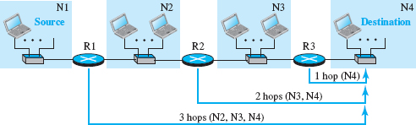
RIP – Hop count
hop count advertised by three routers from a source host to a destination host
In RIP, the maximum cost of a path can be 15, which means 16 is considered as infinity (no connection)
For this reason, RIP can be used only in autonomous systems in which the diameter of the AS is not more than 15 hops

Slide 95
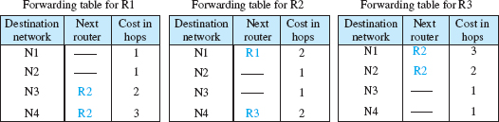
RIP- Forwarding Tables
Routers in an autonomous system need to keep forwarding tables to forward packets to their destination networks
A forwarding table in RIP is a three column table
the address of the destination network
the address of the next router to which the packet should be forwarded
the cost (the number of hops) to reach the destination network
the first and third columns together convey the same information as does a distance vector, but the cost shows the number of hops to the destination networks.

Slide 96
RIP- Forwarding Tables
Although a forwarding table in RIP defines only the next router in the second column, it gives the information about the whole least-cost tree
For example, R1 defines that the next router for the path to N4 is R2; R2 defines that the next router to N4 is R3; R3 defines that there is no next router for this path.
The tree is then R1 → R2 → R3 → N4.
What the use of the third column?
The third column is not needed for forwarding the packet, but it is needed for updating the forwarding table when there is a change in the route

Slide 97
RIP Implementation
uses the service of User Datagram Protocol (UDP) on the well-known port number 520
In BSD, RIP is a daemon process (a process running at the background), named routed (abbreviation for route daemon and pronounced route-dee)
Although RIP is a routing protocol to help IP route its datagrams through the AS, the RIP messages are encapsulated inside UDP user datagrams, which in turn are encapsulated inside IP datagrams.
RIP runs at the application layer, but creates forwarding tables for IP at the network later
RIP has gone through two versions: RIP-1 and RIP-2 (backward-compatible )
RIP-2 allows the use of more information in the RIP messages that were set to 0 in the first version.

Slide 98
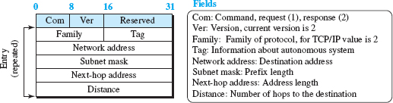
RIP Messages
Two RIP processes, a client and a server need to exchange messages
Part of the message -call an entry
Each entry carries the information related to one line in the forwarding table of the router that sends the message.

Slide 99
RIP Messages
RIP has two types of messages: request and response
A request message
Is sent by a router that has just come up or by a router that has some time-out entries
can ask about specific entries or all entries
A response (or update) message
Solicited - sent only in answer to a request message
contains information about the destination specified in the corresponding request message
Unsolicited- sent periodically, every 30 s or when there is a change in the forwarding table.

Slide 100
RIP Algorithm
Same as the distance-vector routing algorithm
some changes to be made to enable a router to update its forwarding table:
Instead of sending only distance vectors, a router needs to send the whole contents of its forwarding table in a response message.
The receiver adds one hop to each cost and changes the next router field to the address of the sending router
We call each route in the modified forwarding table the received route and each route in the old forwarding table the old route
The received router selects the old routes as the new ones three cases
The new forwarding table needs to be sorted according to the destination route (mostly using the longest prefix first).

Slide 101
RIP Algorithm - three cases
Cases where the received router does not selects the old routes as the new ones
If the received route does not exist in the old forwarding table, it should be added to the route.
If the than cost of the received route is lower the cost of the old one, the received route should be selected as the new one.
If the cost of the received route is higher than the cost of the old one, but the value of the next router is the same in both routes, the received route should be selected as the new one.
the route was actually advertised by the same router in the past, but now the situation has been changed
For example, suppose a neighbor has previously advertised a route to a destination with cost 3, but now there is no path between this neighbor and that destination.
The neighbor advertises this destination with cost value infinity (16 in RIP).
The receiving router must not ignore this value even though its old route has a lower cost to the same destination.

Slide 102
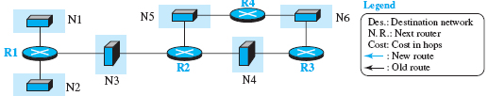

Realistic example of the operation of RIP
All forwarding tables after all routers have been booted

Slide 103
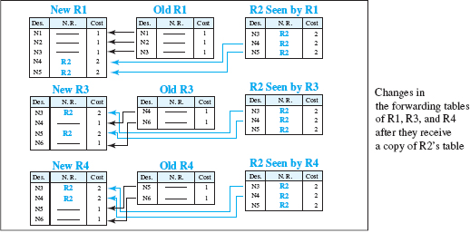
Realistic example of the operation of RIP
Then it shows changes in some tables when some update messages have been exchanged

Slide 104
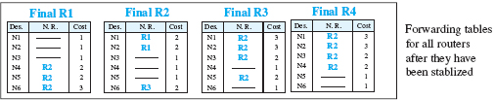
Realistic example of the operation of RIP
Thestabilized forwarding tables when there is no more change

Slide 105
Timers in RIP
RIP uses three timers to support its operation
Periodic timer controls the advertising of regular update messages
Each router has one periodic timer that is randomly set to a number between 25 and 35 s (to prevent all routers sending their messages at the same time and creating excess traffic).
The timer counts down; when zero is reached, the update message is sent, and the timer is randomly set once again
The expiration timer governs the validity of a route
When a router receives update information for a route, the expiration timer is set to 180 s for that particular route.
Every time a new update for the route is received, the timer is reset.
If there is a problem on an internet and no update is received within the allotted 180 s, the route is considered expired and the hop count of the route is set to 16, which means the destination is unreachable.
Every route has its own expiration timer.

Slide 106
Timers in RIP
Garbage collection timer is used to purge a route from the forwarding table.
When the information about a route becomes invalid, the router does not immediately purge that route from its table.
Instead, it continues to advertise the route with a metric value of 16.
At the same time, a garbage collection timer is set to 120 s for that route.
When the count reaches zero, the route is purged from the table.
This timer allows neighbors to become aware of the invalidity of a route prior to purging.

Slide 107
Performance of RIP
Update messages – have a very simple format and are sent only to neighbors (local)
They do not normally create traffic because the routers try to avoid sending them at the same time.
Convergence of forwarding tables - the distance-vector algorithm can converge slowly if the domain is large, but, because RIP allows only 15 hops in a domain (16 is considered as infinity), there is normally no problem in convergence
The only problems that may slow down convergence are count-to-infinity and loops created in the domain;
Solution - use of poison-reverse and split-horizon strategies added to the RIP extension
Robustness - In distance-vector routing, each router sends what it knows about the whole domain to its neighbors
Calculation of the forwarding table depends on information received from immediate neighbors, which in turn receive their information from their own neighbors
If there is a failure or corruption in one router, the problem will be propagated to all routers and the forwarding in each router will be affected.

Slide 108
Open Shortest Path First (OSPF)
An intradomain routing protocol like RIP, but it is based on the link-state routing protocol
OSPF is an open protocol, which means that the specification is a public document.
OSPF concept:
Metric
Forwarding tables
Areas
Link state advertisement
Implementation – OSPF messages, authentication, algorithm
Performance

Slide 109
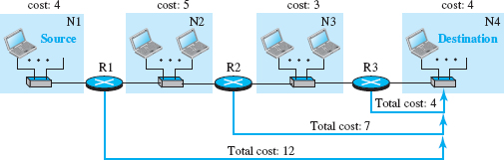
OSPF –Metric
Cost of reaching a destination from the host is calculated from the source router to the destination network
Each link (network) can be assigned a weight based on the throughput, round-trip time, reliability, and so on.
An administration can also decide to use the hop count as the cost
An interesting point about the cost in OSPF is that different service types (TOSs) can have different weights as the cost.

Slide 110
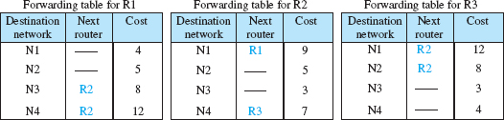
Forwarding Tables
Each OSPF router can create a forwarding table after finding the shortest path tree between itself and the destination using Dijkstra’s algorithm,
If we use the hop count for OSPF, the tables will be exactly the same as RIP because both protocols use the shortest-path trees to define the best route from a source to a destination.

Slide 111
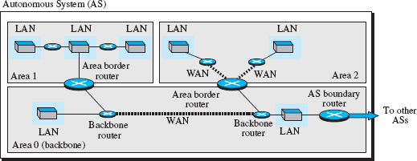
Areas
RIP is normally used in small ASs, OSPF was designed to be able to handle routing in a small or large autonomous system.
The formation of shortest-path trees in OSPF requires that all routers flood the whole AS with their LSPs to create the global LSDB.
Although this may not create a problem in a small AS, it may have created a huge volume of traffic in a large AS
OSPF uses another level of hierarchy in routing: The first level is the autonomous system, the second is the area
The AS needs to be divided into small sections called areas
Each area acts as a small independent domain for flooding LSPs.

Slide 112
However, each router in an area needs to know the information about the link states not only in its area but also in other areas.
For this reason, one of the areas in the AS is designated as the backbone area, responsible for gluing the areas together.
The routers in the backbone area are responsible for passing the information collected by each area to all other areas.
A router in an area can receive all LSPs generated in other areas
For the purpose of communication, each area has an area identification.
The area identification of the backbone is zero

Slide 113
Link-State Advertisement
OSPF is based on the link-state routing algorithm, which requires that a router advertise the state of each link to all neighbors for the formation of the LSDB.
We need to advertise the existence of different entities as nodes, the different types of links that connect each node to its neighbors, and the different types of cost associated with each link
This means we need different types of advertisements, each capable of advertising different situations
We can have five types of link-state advertisements:
router link
network link
summary link to network
summary link to AS border router
external link

Slide 114
Link-State Advertisement
1. Router link - advertises the existence of a router as a node
In addition to giving the address of the announcing router, this type of advertisement can define one or more types of links that connect the advertising router to other entities
A transient link announces a link to a transient network, a network that is connected to the rest of the networks by one or more routers
This type of advertisement should define the address of the transient network and the cost of the link
A stub link advertises a link to a stub network, a network that is not a through network
Again, the advertisement should define the address of the network and the cost
A point-to-point link should define the address of the router at the end of the point-to-point line and the cost to get there.

Slide 115
Link-State Advertisement
2. Network link - advertises the network as a node.
However, because a network cannot do announcements itself (it is a passive entity), one of the routers is assigned as the designated router and does the advertising
In addition to the address of the designated router, this type of LSP announces the IP address of all routers (including the designated router as a router and not as speaker of the network), but no cost is advertised because each router announces the cost to the network when it sends a router link advertisement.
3. Summary link to network -This is done by an area border router; it advertises the summary of links collected by the backbone to an area or the summary of links collected by the area to the backbone
This type of information exchange is needed to glue the areas together.

Slide 116
Link-State Advertisement
4. Summary link to AS - This is done by an AS router that advertises the summary links from other ASs to the backbone area of the current AS, information which later can be disseminated to the areas so that they will know about the networks in other Ass
5. External link -This is also done by an AS router to announce the existence of a single network outside the AS to the backbone area to be disseminated into the areas.

Slide 117
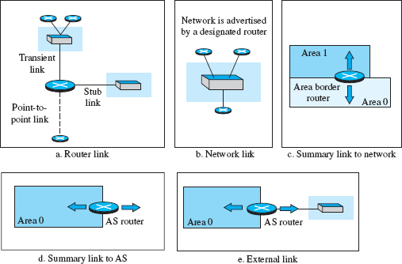
Link-State Advertisement

Slide 118
OSPF Implementation
OSPF is implemented as a program in the network layer that uses the service of the IP for propagation.
An IP datagram that carries a message from OSPF sets the value of the protocol field to 89.
This means that, although OSPF is a routing protocol to help IP to route its datagrams inside an AS, the OSPF messages are encapsulated inside datagrams.
OSPF has gone through two versions: version 1 and version 2.
Most implementations use version 2.

Slide 119
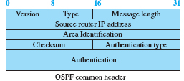


OSPF Messages
OSPF is a very complex protocol; it uses five different types of messages
OSPF common header format (which is used in all messages) and the link-state general header (which is used in some messages)

Slide 120
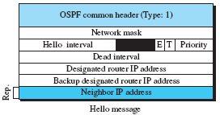
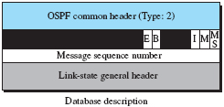

OSPF Messages
Five message types used in OSPF
The hello message (type 1) is used by a router to introduce itself to the neighbors and announces all neighbors that it already knows.
The database description message (type 2) is normally sent in response to the hello message to allow a newly joined router to acquire the full LSDB
The link-state request message (type 3) is sent by a router that needs information about a specific LS

Slide 121
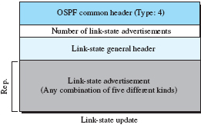

OSPF Messages
The link-state update message (type 4) is the main OSPF message used for building the LSDB
This message, in fact, has five different versions (router link, network link, summary link to network, summary link to AS border router, and external link),
The link-state acknowledgment message (type 5) is used to create reliability in OSPF
each router that receives a link-state update message needs to acknowledge it.

Slide 122
Authentication
The OSPF common header has the provision for authentication of the message sender to prevents a malicious entity from sending OSPF messages to a router and causing the router to become part of the routing system to which it actually does not belong

Slide 123
OSPF Algorithm
OSPF implements the link-state routing algorithm
Some changes and augmentations need to be added to the algorithm:
After each router has created the shortest-path tree, the algorithm needs to use it to create the corresponding routing algorithm.
The algorithm needs to be augmented to handle sending and receiving all five types of messages.

Slide 124
Performance
Update messages - The link-state messages in OSPF have a somewhat complex format
They also are flooded to the whole area
If the area is large, these messages may create heavy traffic and use a lot of bandwidth.
Convergence of forwarding tables. - When the flooding of LSPs is completed, each router can create its own shortest-path tree and forwarding table; convergence is fairly quick. However, each router needs to run the Dijkstra’s algorithm, which may take some time.
Robustness - The OSPF protocol is more robust than RIP because, after receiving the completed LSDB, each router is independent and does not depend on other routers in the area
Corruption or failure in one router does not affect other routers as seriously as in RIP.

